Slide 1

Unit 1 Analysis of Algorithms
Prof. Kinjal Mistree
Department of Computer Engineering
CGPIT, UTU

Slide 2
Outline
Algorithm
Efficiency of algorithms
Performance analysis of algorithm
Average and worst case analysis Elementary operation
Asymptotic Notation
Analyzing control statements
Solving recurrences

Slide 3
Algorithm

Slide 4

What is an algorithm?
A step-by-step procedure, to solve the different kinds of problems.
Suppose, we want to make a Chocolate Cake.
An unambiguous sequence of computational steps that transforms the input into the output.
Input
Process
Output
Ingredients
Recipe
Cake

Slide 5

What is an algorithm?
An algorithm is well defined computational procedure that takes some value, or set of values as input and produces some value, or set of values as output.
Input
Algorithm
Program
Output

Slide 6
Characteristics of an algorithm
Finiteness: An algorithm must always terminate after a finite number of steps.
Definiteness: Each step of an algorithm must be precisely defined.
Input: An algorithm has zero or more inputs.
Output: An algorithm must have at least one desirable output.
Effectiveness: All the operations to be performed in the algorithm must be sufficiently basic so that they can, in principle be done exactly and in a finite length of time.

Slide 7
Algorithm vs Pseudocode
Algorithm | Pseudocode
An algorithm is a sequence of steps which is utilized in order to solve a computational problem. | Pseudocode is a detailed description of an algorithm which is easier to read and is expressed in an English-like language.
The algorithm uses high-level constructs like snippet of code. | Pseudocode involves natural language with high-level programming builds.
Cooking recipe can be considered to be an algorithm if it describes precisely how to make certain dish, giving exact quantities to use and detailed instructions for how long to cook it. | Cooking recipe can be considered to be an pseudocode if it includes vague notations like “add salt to taste” or “cook until tender”.

Slide 8
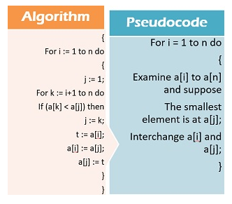
Algorithm vs Pseudocode

Slide 9
Algorithm vs Flowchart
Algorithm | Flowchart
An algorithm is step wise analysis of the work to be done. | Flowchart is a pictorial representation of an algorithm.
An algorithm is a precise set of rules specifying how to solve some problem. | A flowchart is a diagram of the sequence of operations in a computer program.

Slide 10
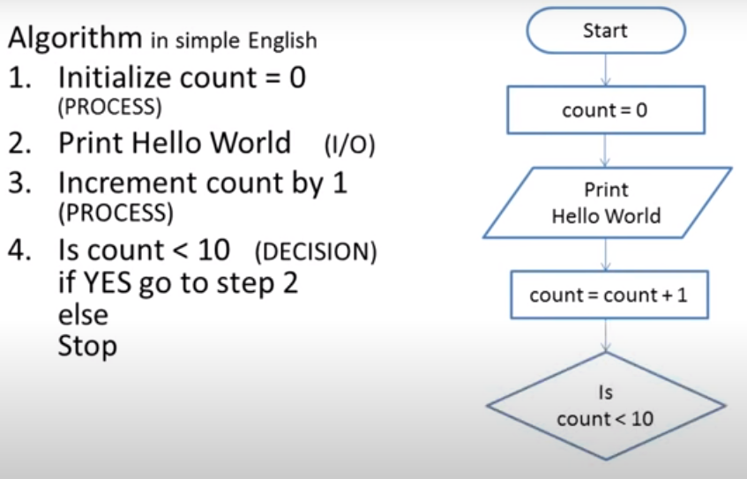
Algorithm vs Flowchart

Slide 11
Study of an algorithm includes..
How to device an algorithm
How to validate an algorithm
How to analyze an algorithm
Testing a program
How to evaluate performance of an algorithm

Slide 12
Importance of choosing a right algorithm (Simple Multiplication Methods)
1. American approach
2. English approach
9 8 1
9 8 1
1
2
3
4
1
2
3
4
3 9 2 4
9 8 1
2 9 4 3
1 9 6 2
1 9 6 2
2 9 4 3
9 8 1
3 9 2 4
1 2 1 0 5 5 4
1 2 1 0 5 5 4

Slide 13
Importance of choosing a right algorithm (Simple Multiplication Methods)
981
1234
1234
à 𝒍𝒂 𝒓𝒖𝒔𝒔𝒆 multiplication
Write the multiplicand and multiplier side by side.
Make two columns, one under each operand.
Repeat step iv and v until the number in the left column is 1.
Divide the number in the left hand column by 2, ignoring any fractions.
Double the number in the right hand column by adding it to itself.
Next cross out each row where the number in the left hand column is even.
Finally add up the numbers that remain in the right hand column.
490
2468
245
4936
4936
122
9872
61
19744
19744
30
39488
15
78976
78976
7
157952
157952
3
315904
315904
1
631808
631808
1210554

Slide 14
Importance of choosing a right algorithm (Simple Multiplication Methods)
4. Multiplication by divide and conquer
Both the multiplicand and the multiplier must have the same number of digits and this number be a power of 2. If not then it can be done by
adding zeros on the left if necessary.
Multiplicand | 0 9 8 1
Multiplier | 1 2 3 4
Multiply left half of the multiplicand by left half of multiplier and shift the result by no. of digits of multiplier i.e. 4.
Multiply left half of the multiplicand by right half of the multiplier, shift the result by half the number of digits of multiplier i.e. 2.
Multiply right half of the multiplicand by left half of the multiplier, shift the result by half the number of digits of multiplier i.e. 2.
Multiply right half of the multiplicand by right half of the multiplier the result is not shifted at all.
Multiply | Shift | Result
(09) * (12) | 4
1
0
8
.
.
.
.
(09) * (34) | 2
3
0
6
.
.
(81) * (12) | 2
9
7
2
.
.
(81) * (34) | 0
2
7
5
4
1 2 1 0 5 5 4

Slide 15
Efficiency of Algorithm

Slide 16
Analysis of Algorithm
What is the analysis of an algorithm?
Analyzing an algorithm means calculating/predicting the resources that the algorithm requires.
Two most important resources are computing time (time complexity) and storage space (space complexity).
Why analysis is required?
By analyzing some of the candidate algorithms for a problem, the most efficient one can be easily identified.

Slide 17
Approaches for selecting efficient algorithm
There are two essential approaches to measuring algorithm efficiency:
Empirical analysis:
Program the algorithm and measure its running time on example instances
Theoretical analysis:
Derive a function which relates the running time to the size of instance
In this course our focus will be on Theoretical analysis.

Slide 18
Approaches for selecting efficient algorithm
Empirical (posteriori) approach | Theoretical (priori) approach
Programming different competing techniques & running them on various inputs using computer. | Determining mathematically the resources needed by each algorithm.
Implementation of different techniques may be difficult. | Uses the algorithm instead of an implementation.
The same hardware and software environments must be used for comparing two algorithms. | The speed of an algorithm can be determined independent of the hardware/software environment.
We have to test our algorithm only on small no. of instances. | We can consider larger no. of instances to test our algorithm.

Slide 19
Problem & Instance
Instance: An Instance of a problem consists of the input needed to compute the solution to the problem.
Example:
Problem: to multiply two positive numbers
Instance: 981 𝑋 1234
Instance size: Any integer (generally 𝒏) that in some way measures the number of components in an instance.
Examples:
Sorting problem: Instance size is number of elements to be sorted.
Graph problem: Instance size is number of nodes or edges or both.

Slide 20
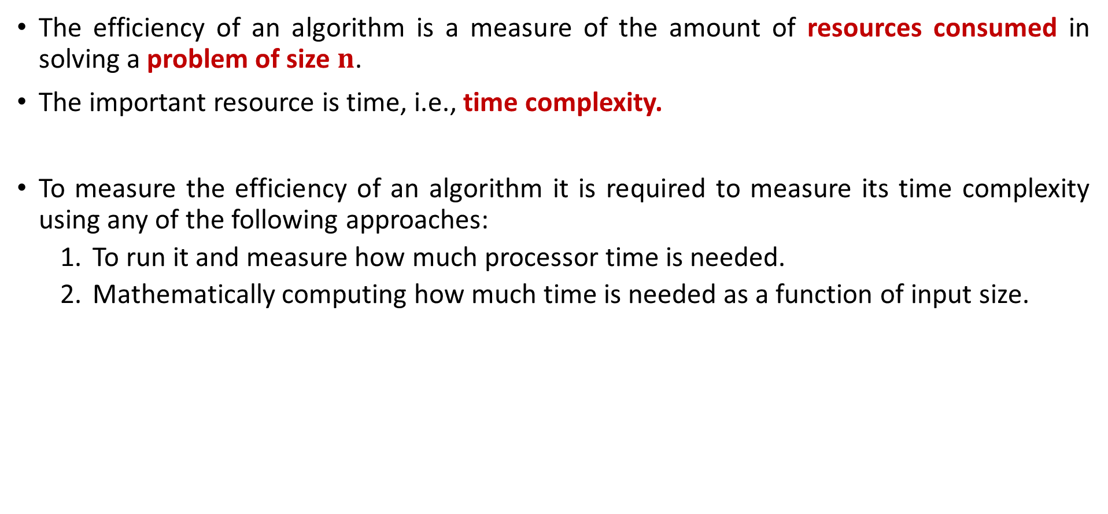
Efficiency of Algorithm
The efficiency of an algorithm is a measure of the amount of resources consumed in solving a problem of size $n$.
The important resource is time, i.e., time complexity.
To measure the efficiency of an algorithm it is required to measure its time complexity using any of the following approaches:
To run it and measure how much processor time is needed.
Mathematically computing how much time is needed as a function of input size.
Empirical Approach
Theoretical Approach

Slide 21
Efficiency of Algorithm
Running time of an algorithm depends upon,
Input Size
Nature of Input
Generally time grows with the size of input, for example, sorting 100 numbers will take less time than sorting of 10,000 numbers.
So, running time of an algorithm is usually measured as a function of input size.
In theoretical computation of time complexity, Running time is measured in terms of number of steps/primitive operations performed.

Slide 22



